Slide 1
Examining Musical Instrument Family Classifier Features
Landon Buell
4 May 2020

Slide 2
Updates
Reorganized & Consolidated Flow of Main program
Attempting to build “Course” level classifier
Classify Soundwaves according to family
Collapses 19 classes into 4 classes

Slide 3
Instrument Classes
Class 0 – Brass Instruments (Red)
Class 1 – Stringed Instruments (Purple)
Class 2 – High Woodwinds (Brown)
Class 3 – Low Woodwinds (Gray)

Slide 4
Progress with MLP
Successful construction of mathematical foundation of Multilayer Perceptron Model
Convolutional Network Might be useful for Comparisons in Frequency-Spectrum
Move To Keras/TF for more advanced models?
Shift Focus to SVM?

Slide 5
Current Goal
Find Classification Features derived from Waveform

Slide 6
Inspiration
“The ﬁrst step in a classiﬁcation problem is typically data reduction. The data reduction stage which is also called feature extraction, consists of discovering a few important facts about each class. The choice of features is critical as it greatly affects the accuracy of audio classiﬁcation. The selected features must reﬂect the signiﬁcant characteristics of each class of audio signals. In order to better discriminate different classes of audio, we consider features that are related to the temporal and spectral domains.”
Khan, M. Kashif Saeed, and Wasfi G. Al-Khatib. “Machine-Learning Based Classification of Speech and Music.” Multimedia Systems, vol. 12, no. 1, 2006, pp. 55–67., doi:10.1007/s00530-006-0034-0.

Slide 7
Time - Domain Features
Currently implemented

Slide 8
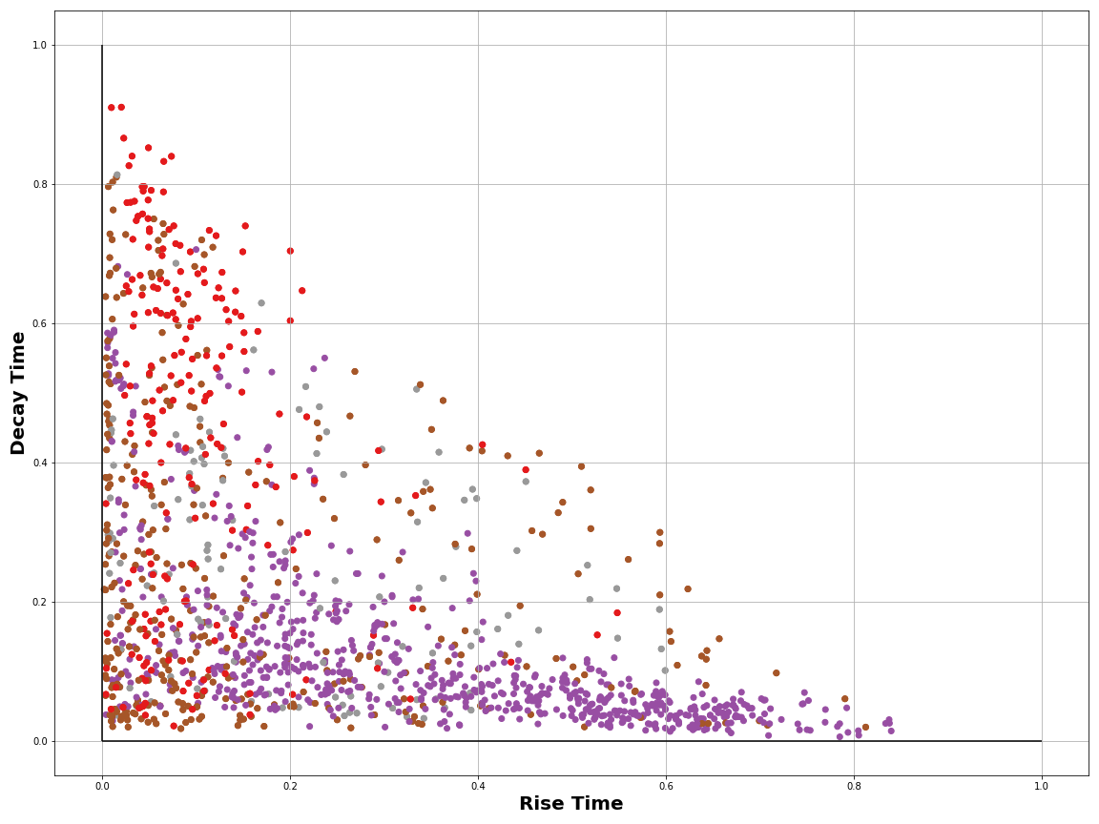
Rise / Decay Time
Rise: 10% - 90% of amplitude
Decay: 90% to 10% of amplitude
Normalized to account for length of file

Slide 9
Constructing “Frames”
Divide a waveform into segments
Combine integer number of samples to make “frame”
Slice of audio ~10 - 40 ms long
Allows to compute “energy” of frame

Slide 10
RMS Energy of Frames
Within each frame, we can loosely approximate energy
Energy ~ Amplitude-squared & integrate over time
Used energy of each frame to compute RMS energy for waveform
Used as a rough energy metric, normalized by waveforms’ length
Bigger RMS ~ greater volume/time ratio

Slide 11
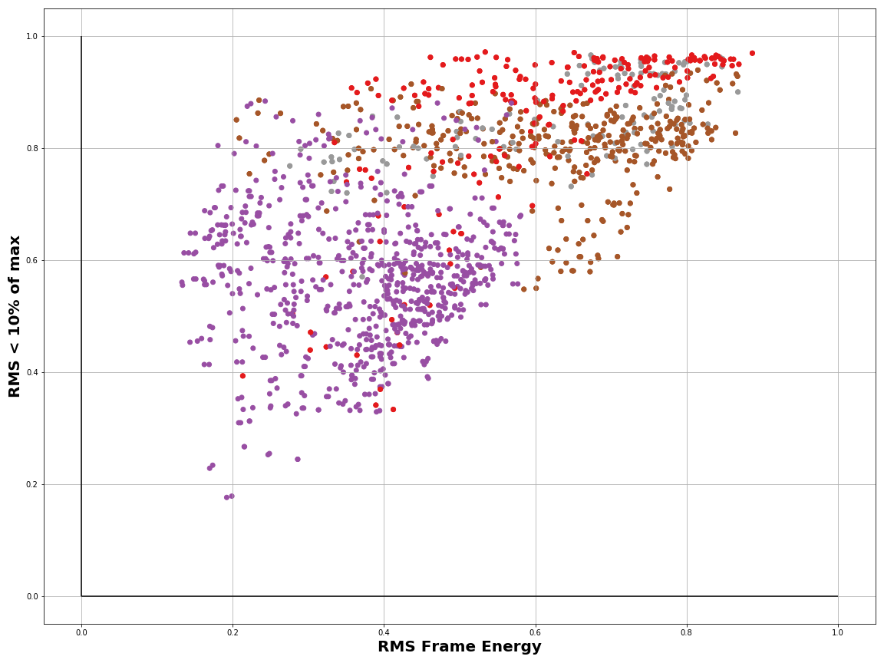
RMS Energy / Frames with < 10% of RMS Energy
RMS Energy of frames vs. Number of frames with energy less than 10% of RMS
Ex: Red = Brass
About 90% of frames have less than 10% of RMS energy
Indicates low vol/time ratio
Ex: Purple = Strings
Lower RMS energy than other classes
Longer sustain?

Slide 12
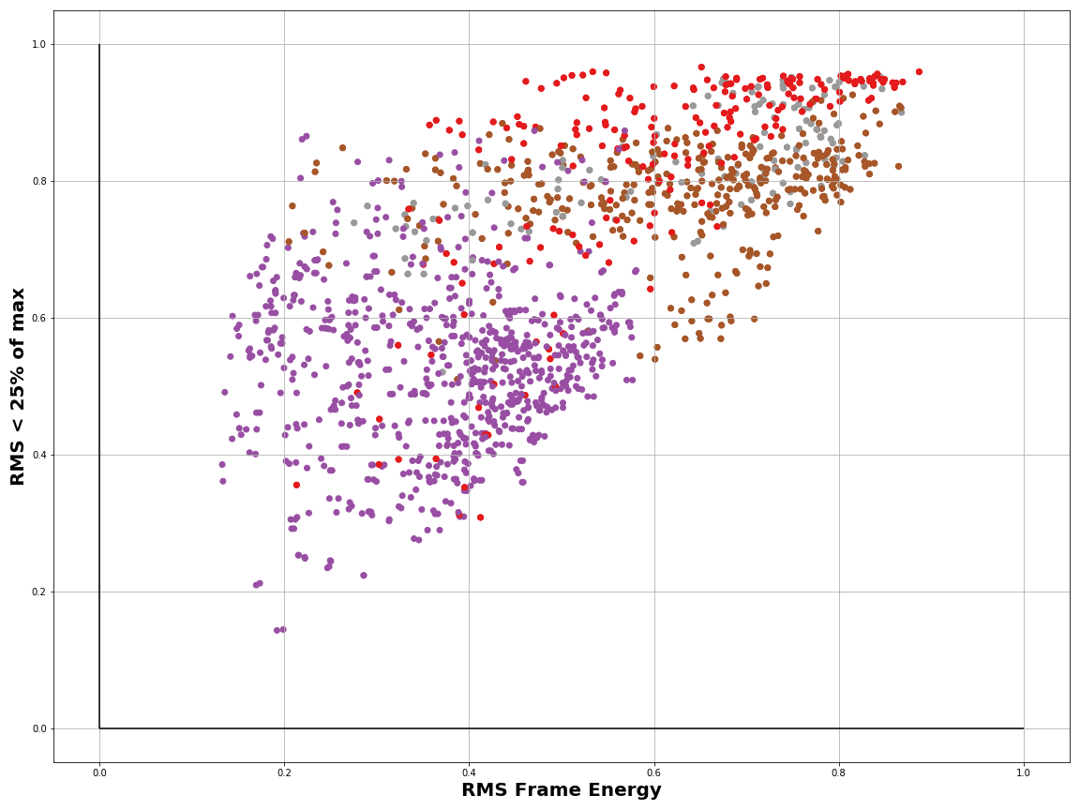
RMS Energy / Frames with < 25% of RMS Energy
RMS Energy of frames vs. Number of frames with energy less than 25% of RMS
Very similar to previous metric
Slightly lower variance

Slide 13
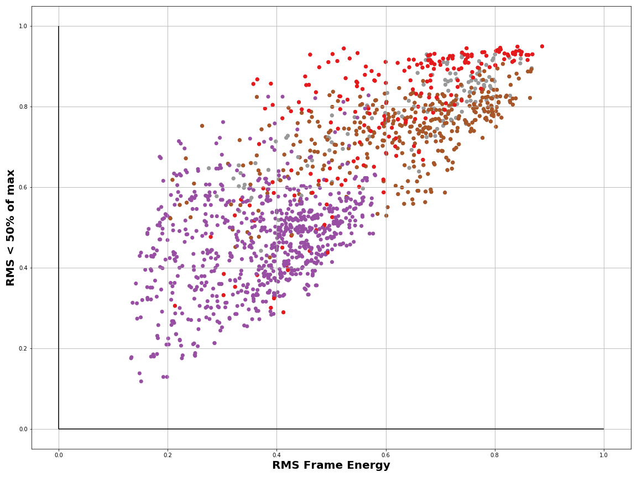
RMS Energy / Frames with < 50% of RMS Energy
RMS Energy of frames vs. Number of frames with energy less than 50% of RMS
Notice how tend line shifts down
Less frames/sample have RMS > 50% of RMS

Slide 14
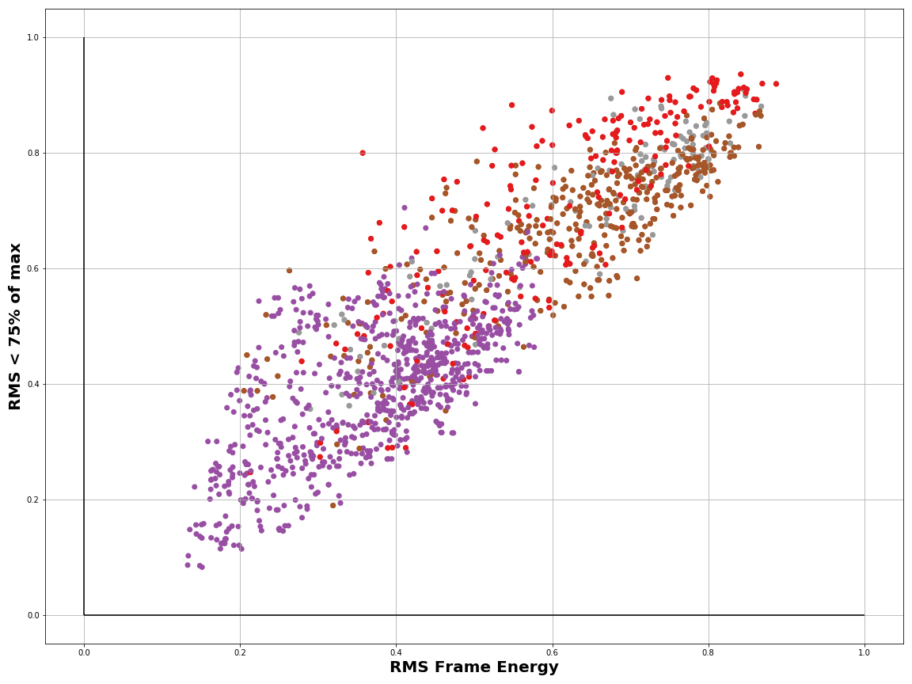
RMS Energy / Frames with < 75% of RMS Energy
RMS Energy of frames vs. Number of frames with energy less than 50% of RMS
Trend continues! – See last 3 slides
Possible decision boundary can be observed?
Strings have fewer frames <75%, greater sustain!

Slide 15
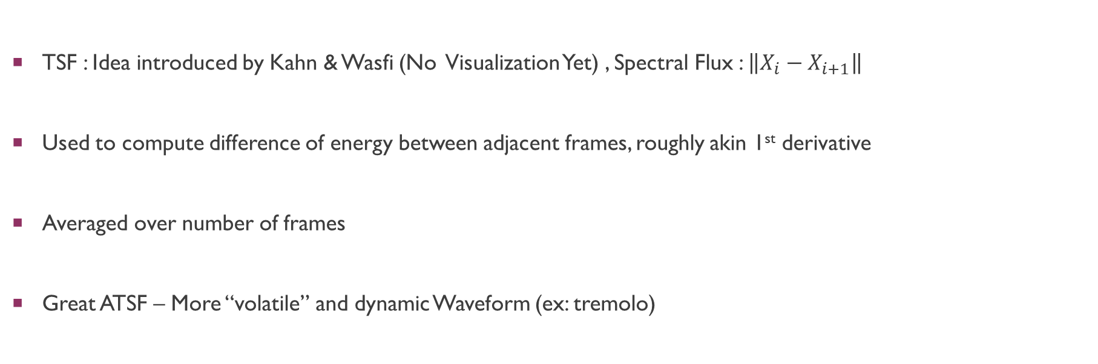
Average Time Spectral Flux
TSF : Idea introduced by Kahn & Wasfi (No Visualization Yet) , Spectral Flux : $\left\|X_{i}−X_{i+1}\right\|$
Used to compute difference of energy between adjacent frames, roughly akin 1st derivative
Averaged over number of frames
Great ATSF – More “volatile” and dynamic Waveform (ex: tremolo)

Slide 16
Frequency – Domain Features
Not Yet Implemented

Slide 17
Number of Distinct Peaks in power Spectrum
Some instruments have more overtones than other
Number of overtones can depend frequency of fundamental
Can be used as classification feature

Slide 18
Power of Successive Overtones
Overtones tend to decrease in strength
Ratio of decreasing values could give rough indication of timbre
Essentially a “power envelope” in frequency spectrum

Slide 19
Spectrogram Information
Combines time & frequency domains to build more features
Track number of overtones in signal w.r.t time of signal
Potential for many features in frequency vs. time domain

Slide 20
Next work
May , June

Slide 21
Feature Scaling
Modifying features – exponentiation, combining, can reveal clearer decision boundaries
1
Standard Scaling – Center Design matrix (Almost a necessity w/ NN)
2
Mean = 0 , Variance = 1

Slide 22
Next Machine learning Models
It is unlikely that a single algorithm will suffice
Framework is built around a “Course Classifier” – Need to adapt to increase number of features?
Thorough Mathematical understanding of how MLP works, move on to new ML methods?

